Slide 1
AWS – Web Service Team
Edwin Rodriguez
Sherelene De Belen
Chris Koepke
Emily Perez
Nathan Angelo Loredo

Slide 2
Agenda
I. Project Overview
II. Technology used
III. Data Flow
V. Endpoints
VI. Demo
IV. Development

Slide 3
Project Overview
Project Objective
Create a cloud-based program with an objective of detecting/predicting wildfires
Web Service Project Scope
Process inputs and output of endpoints from back-end and front-end
Input: Date, Past 30 days, Past 60 days, Past 90 days
Output: Prediction

Slide 4





Technology Used
Programming Language
Python
Cloud
Amazon Web Service
Database
MySQL
File Format
JSON
API Testing
Postman

Slide 5
Technology Used
Programming Language
Cloud
Database
File Format
API Testing

Slide 6
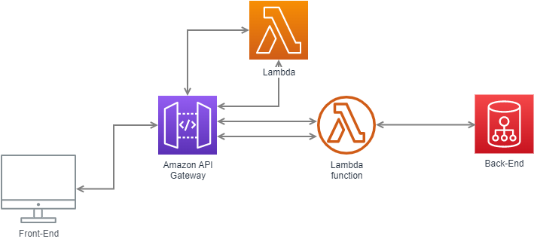
Data Flow

Slide 7
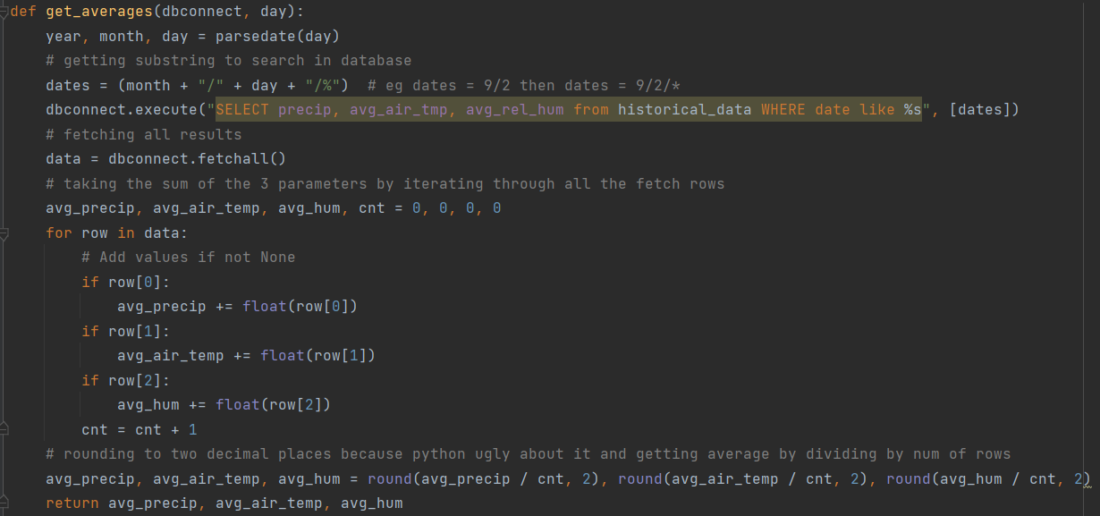
Development

Slide 8
Endpoints
Predict
Expected Payload Body: {"date": "11/22/2052", "rain30d": 1.1, "rain60d": 2.2, "rain90d": 3.3}
Fetch Single Record
Expected Payload Body: {"location_id": 5}
Fetch Multiple Records
Expected Payload Body: {"locations": [250, 251]}
Fetch All Locations
Expected Payload Body: {"location_id": "all"}
Fetch Location ID List
Expected Payload Body: {"location_id": "all"}
Add Records
Expected Payload Body: {"records": [[111.111, -111.111, "Station 111" ], [222.222, -222.222, "Station 222"]]}
Delete Records
Expected Payload Body: {"locations": [269, 270]}

Slide 9
Demo

Slide 10
Thank you for listening!

